Slide 1
BIKE BUYER DATA ANALYSIS
Full project in Excel

Slide 2
Table of content
Bike buyer data analysis
Purpose Statement (What are we talking about?)
Storytelling (with data)
Conclusion

Slide 3
Purpose Statement
Identifying if there any factor from table column that lead to
bike purchasing and to determine which factor for each type
of buyers that the company should take into consideration
for their sales performance.

Slide 4
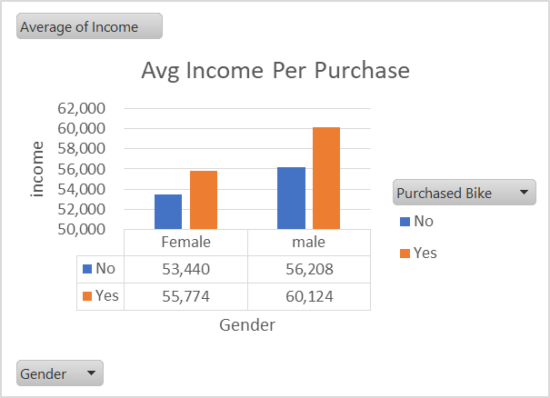
Income variable (Female and Male)
Both male and female with income between 50,000 and 100,000 are likely to purchase a bike. Therefore people with an income of less 100,000 are most likely to purchase a bike compared with the ones with an income above 100,000 for both male and females.

Slide 5
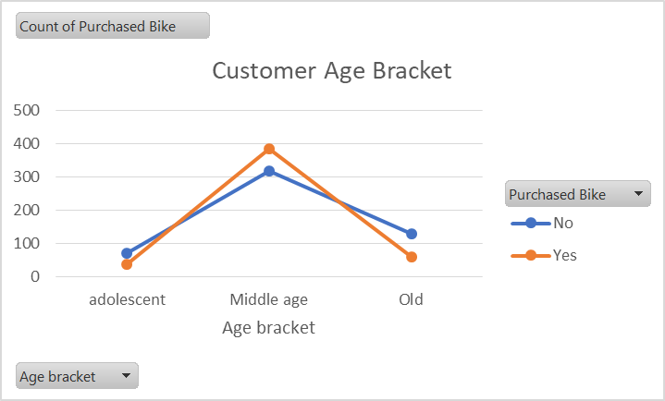
Age Bracket Variable (adolescent, middle age and old)
At first sight we can clearly see that middle aged people made the highest number of purchase compared to the adolescent and old ones, the reason for this may be a result of income as most of the middle aged people may be earning less 100,00 or they are single hence prefer a bike than a car.

Slide 6
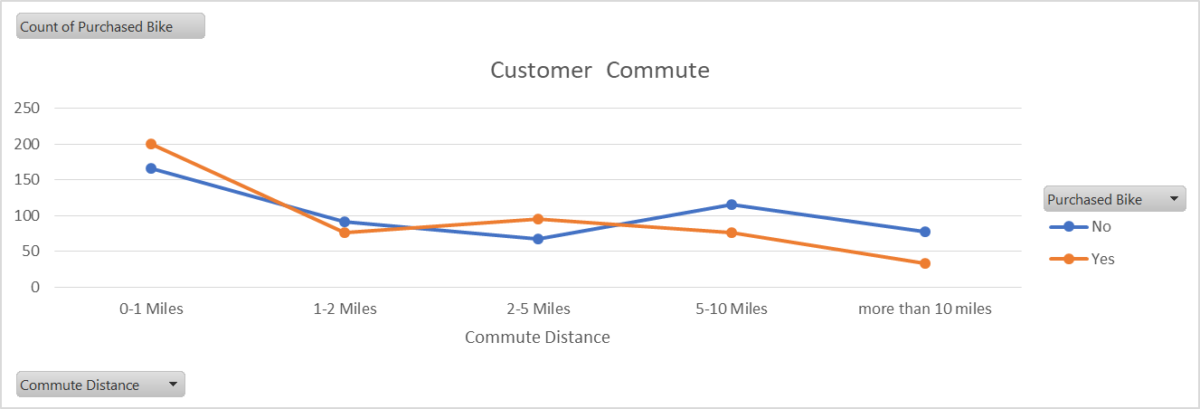
Commute Distance Variable
People commuting between a distance of 1-2 miles away made a massive purchase of bikes, this will be as a result of the short distance or they uses the bikes in their day to day movement as its not costly as other means of transport.

Slide 7
Conclusion
The company should focus mostly with middle aged people, earning an average income, and the ones with a less commute distance. These are the people that recorded the highest purchase of bikes. The company should target on how to introduce fun bikes for the adolescent and also exercise bikes for the old age people.
The old, high income people and the ones that commute from far should be considered by the company, this is through introduction of average price bikes with kind of easy cyclist since they will buy a bike just for fun on a weekend.

